Slide 1
RAMCO INDUSTRIES LIMITED
SHEET STACKING

Slide 2
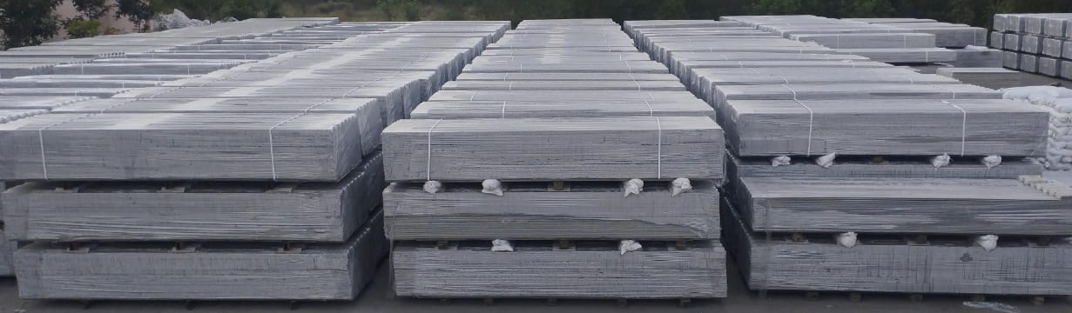
3.6 m Line

Slide 3
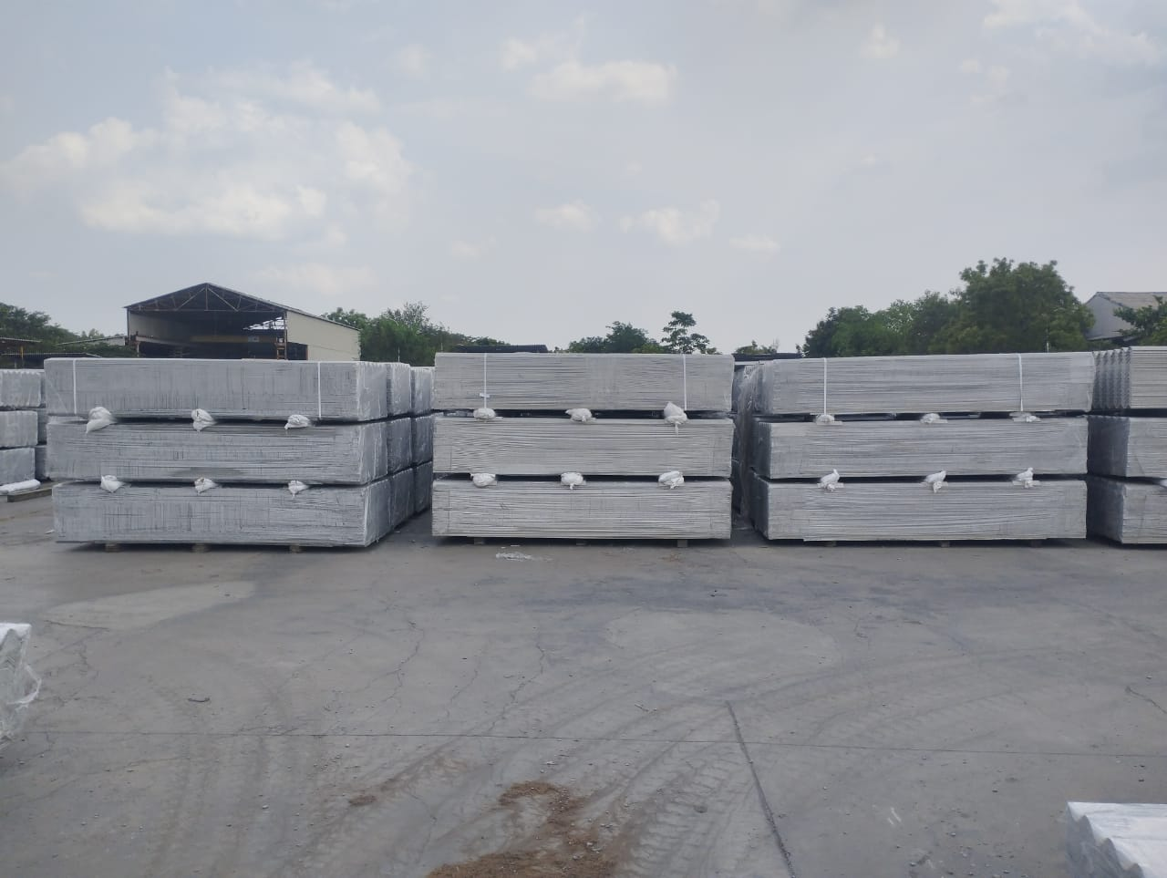
3.0m Line

Slide 4
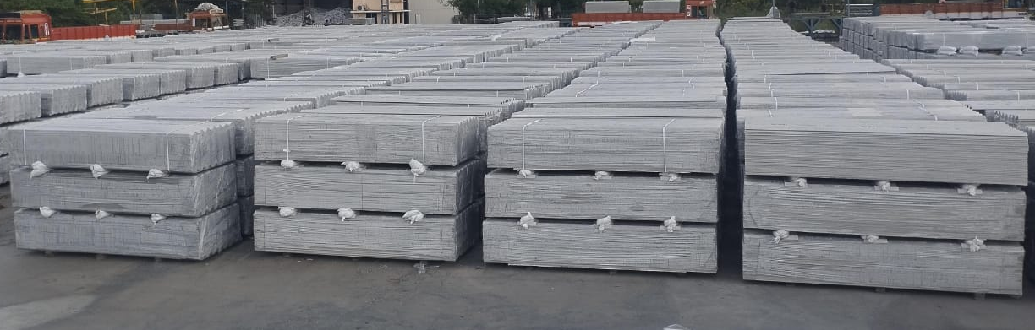
3.0m Line

Slide 5
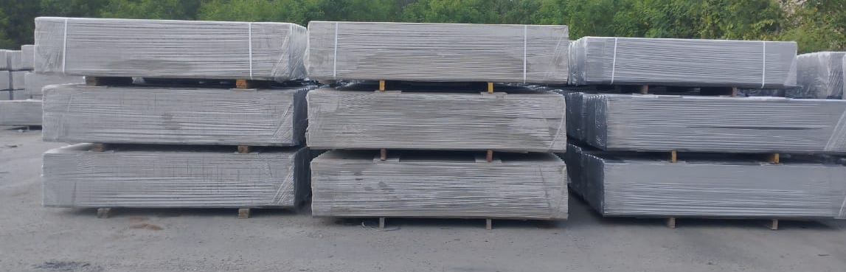
2.5m Line

Slide 6
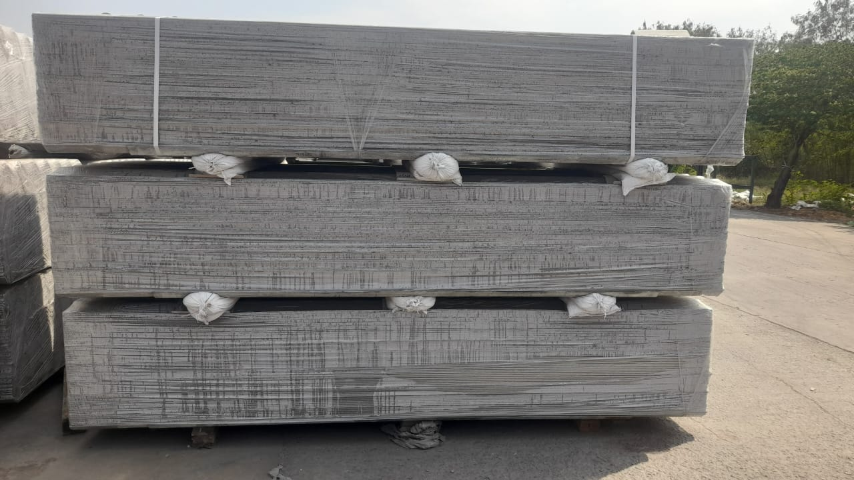
3.0m 3×60 180 Nos Uplap

Slide 7
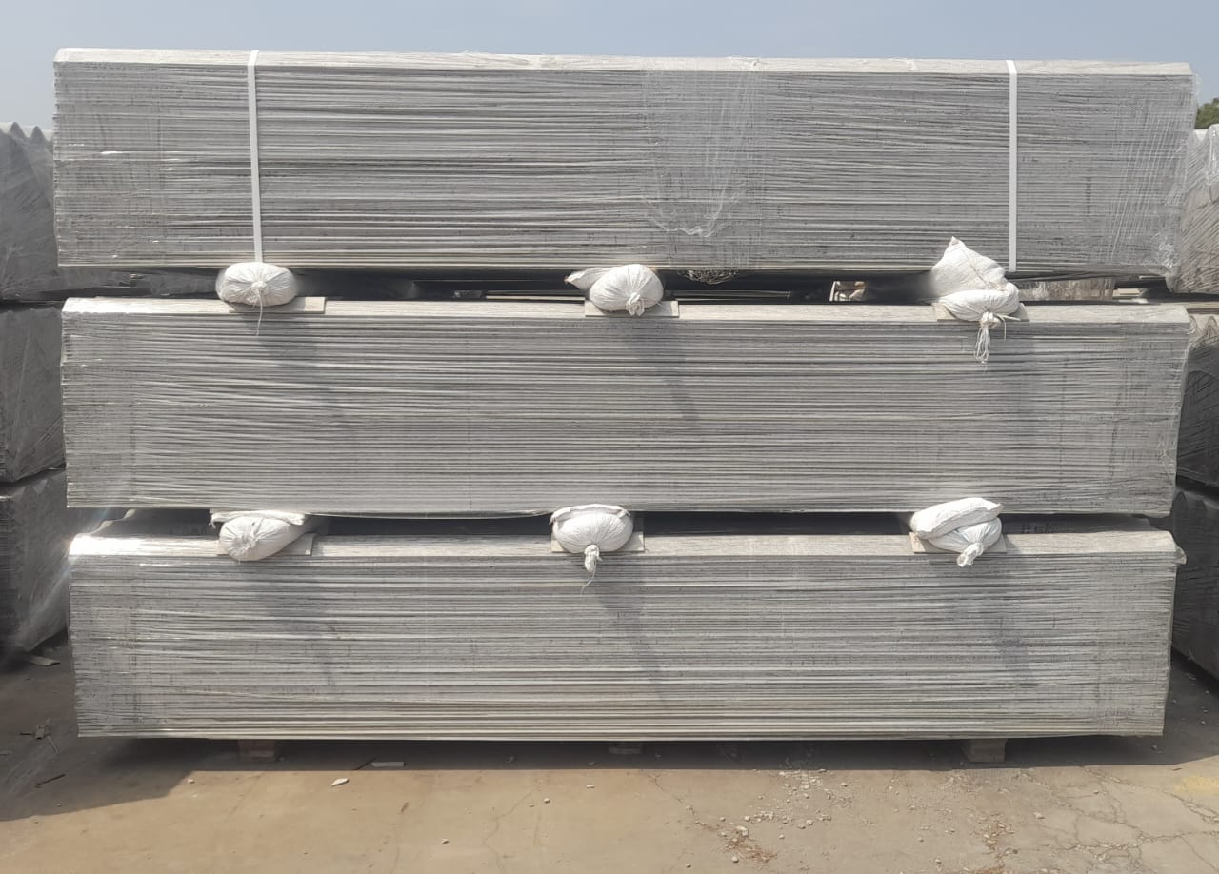
3.0m 3×60 180Nos Down Lap

Slide 8
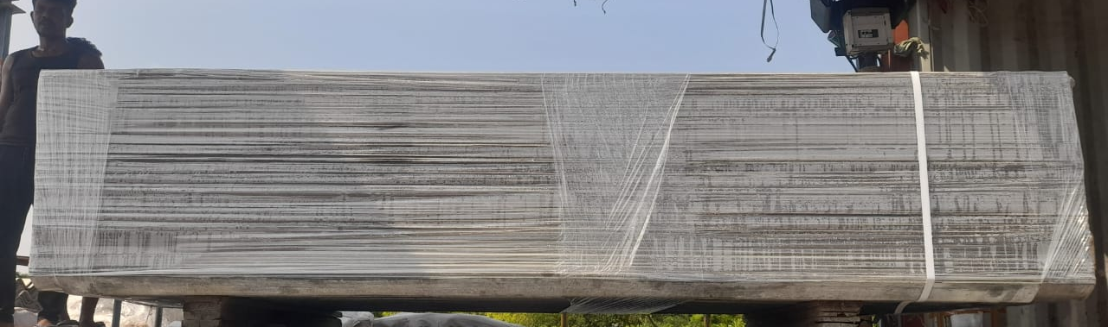
2.5m 60 No’s Up lap

Slide 9
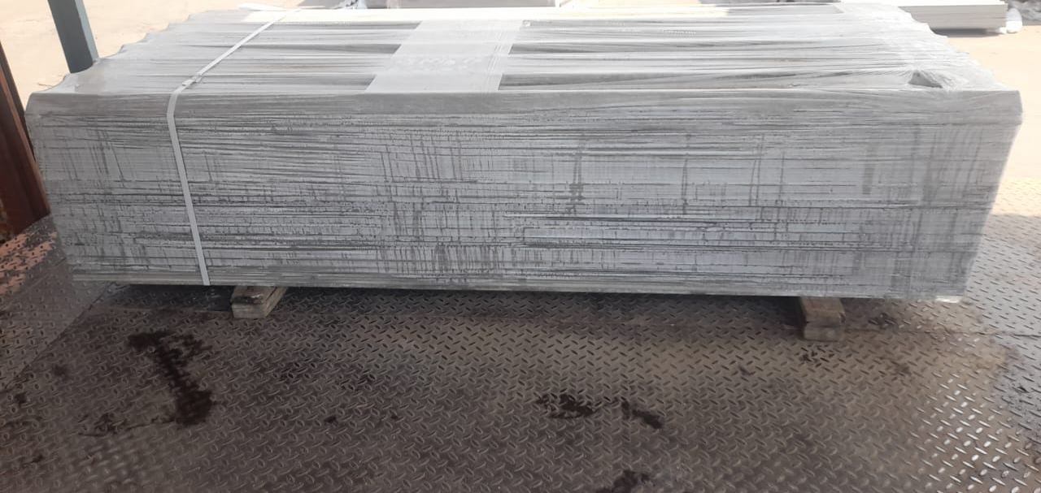
2.5m 60No’s Down lap

Slide 10
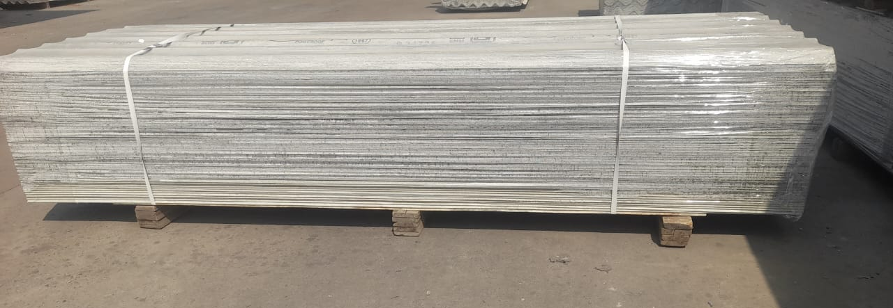
3 m 60No’s Down lap

Slide 11
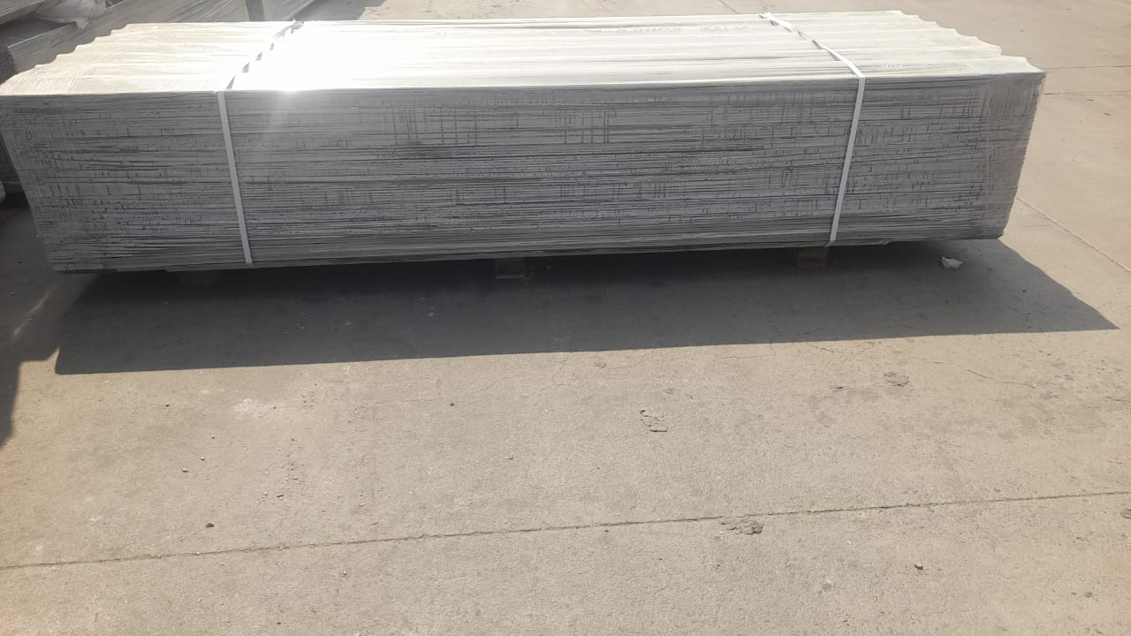
3.0m 60No’s up Lap

Slide 12
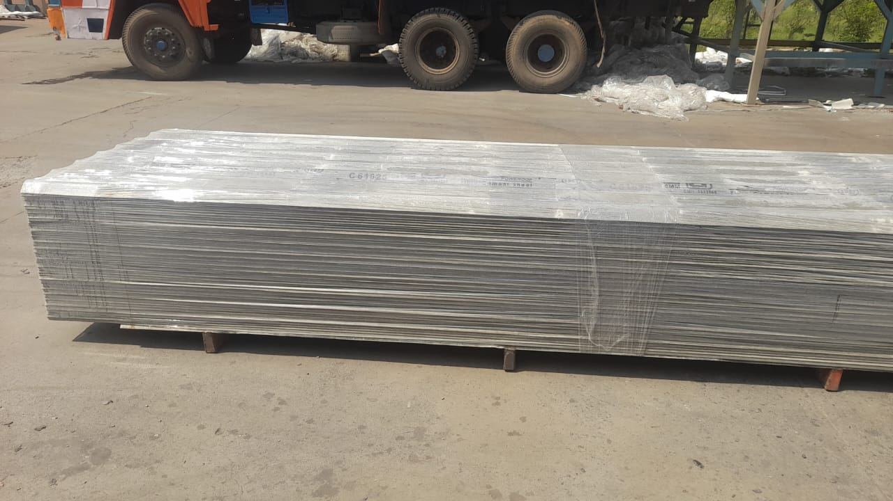
3.6m 60 No’s Down Lap

Slide 13
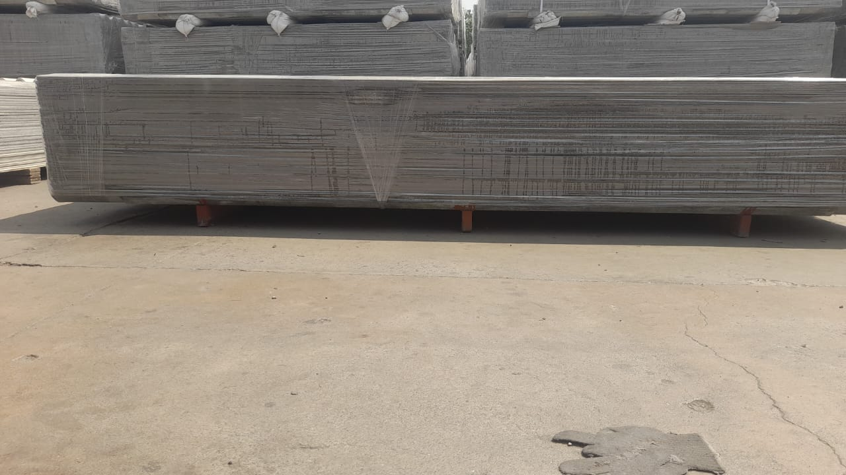
3.6m 60 No’s up Lap

Slide 14
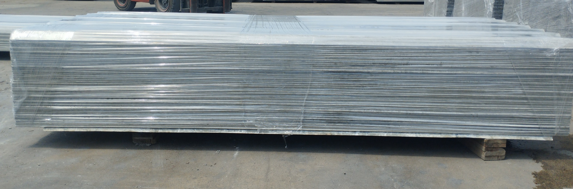
2.50m 47 No’s Down Lap

Slide 15
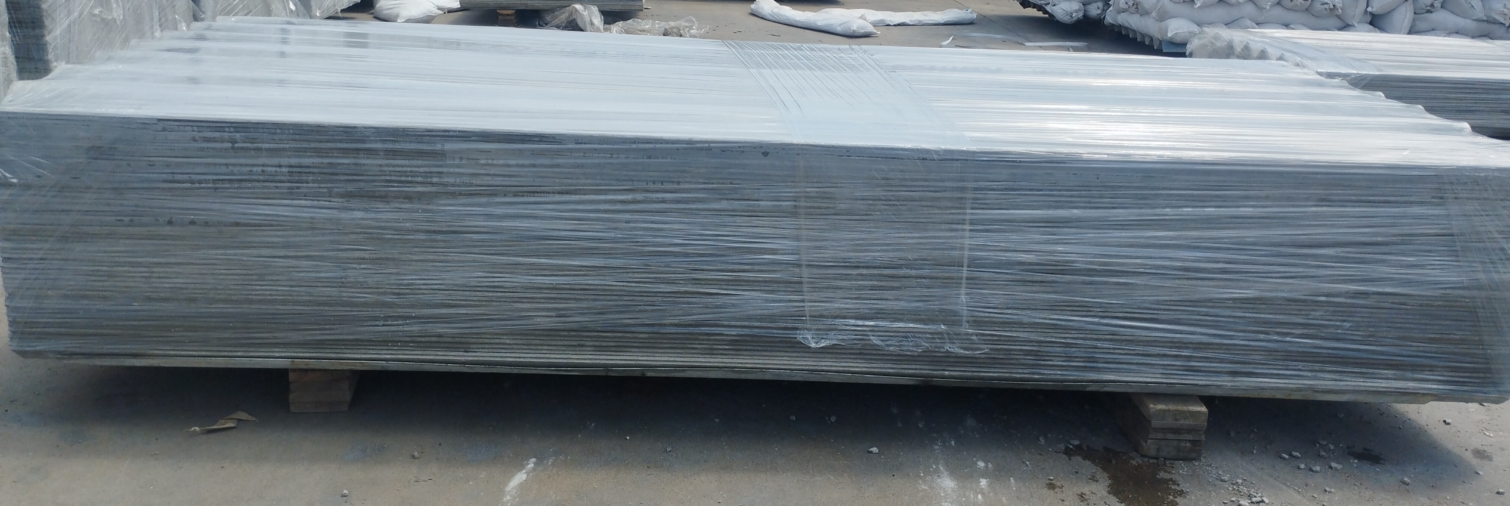
2.50m-47 No’s up Lap

Slide 16
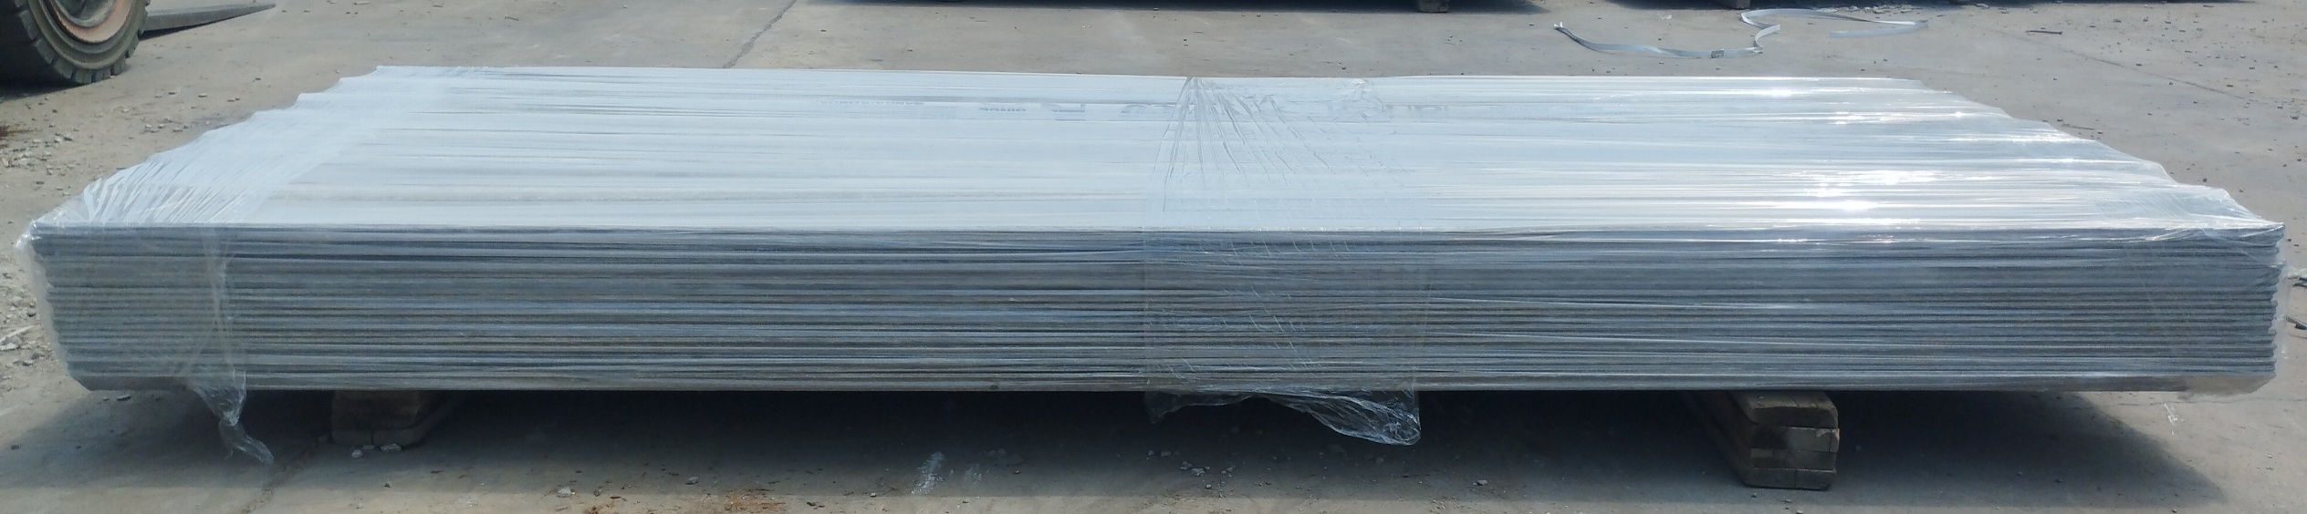
2.5 m Up Lap 21 No’s

Slide 17
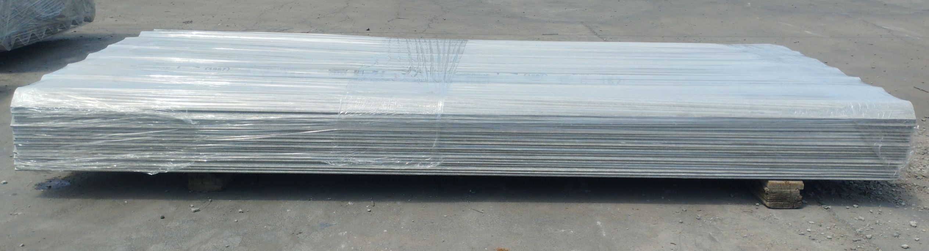
2.5 m Down Lap 21 No’s

Slide 18
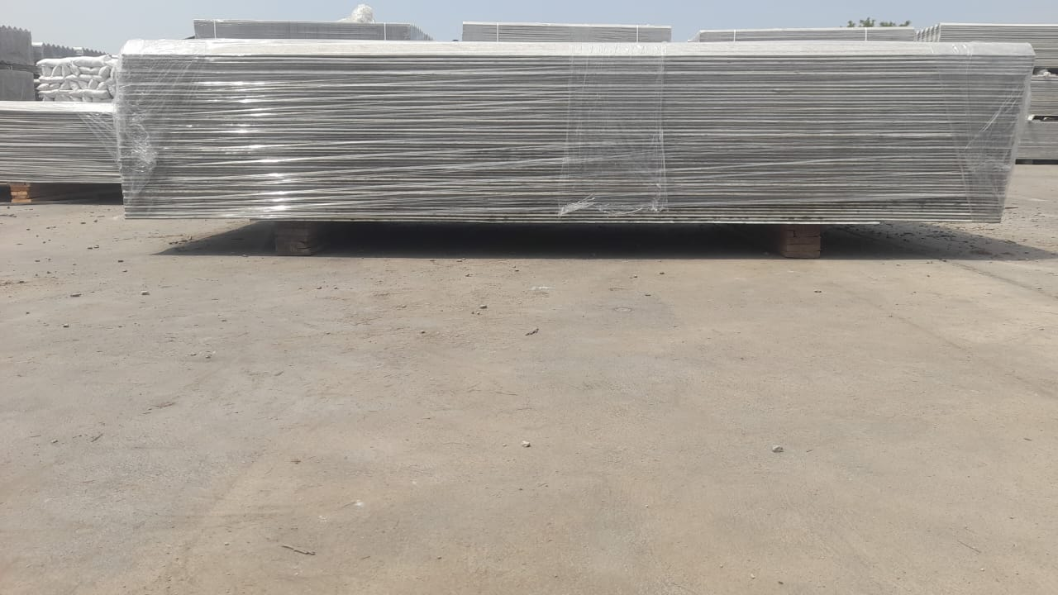
2.5m 52No’s Down Lap

Slide 19
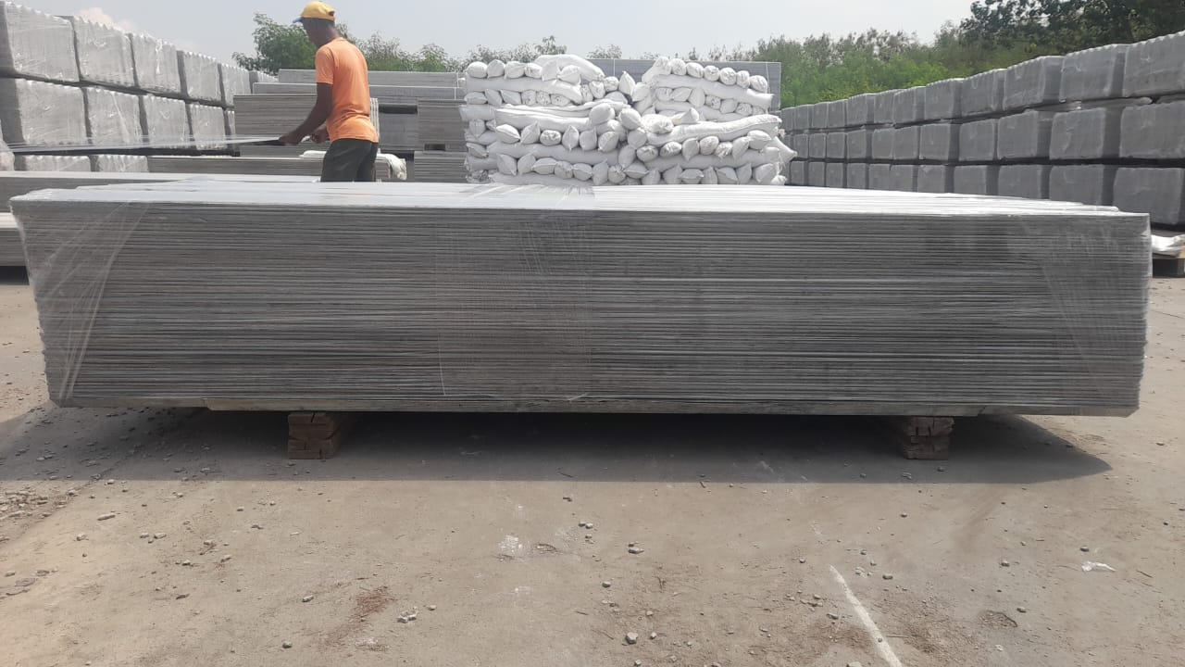
2.5m 52 No’s Up Lap

Slide 20
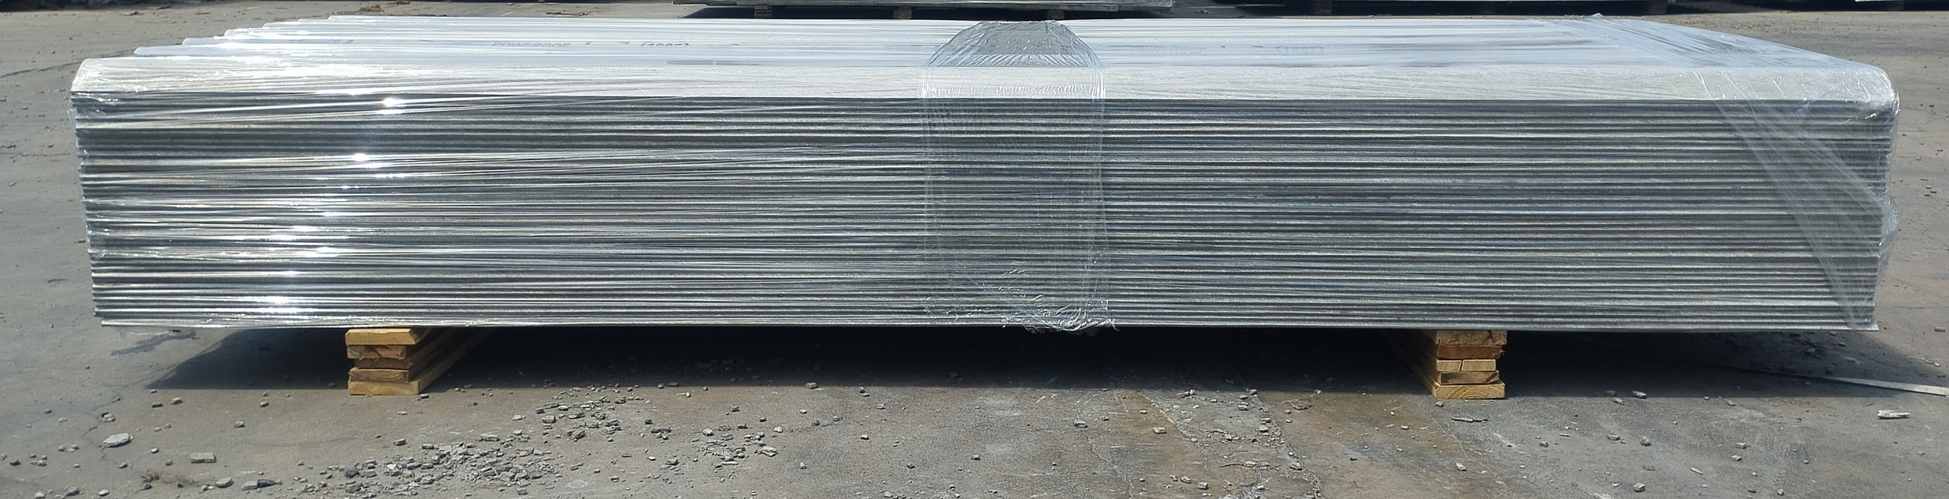
2.50m- Down Lap-38 No’s

Slide 21
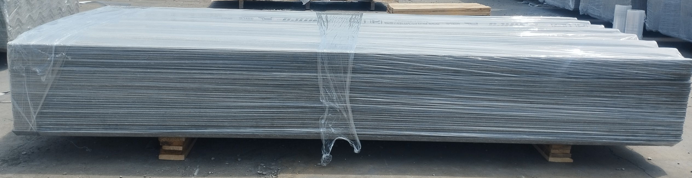
2.50m- Up Lap-38 No’s

Slide 22
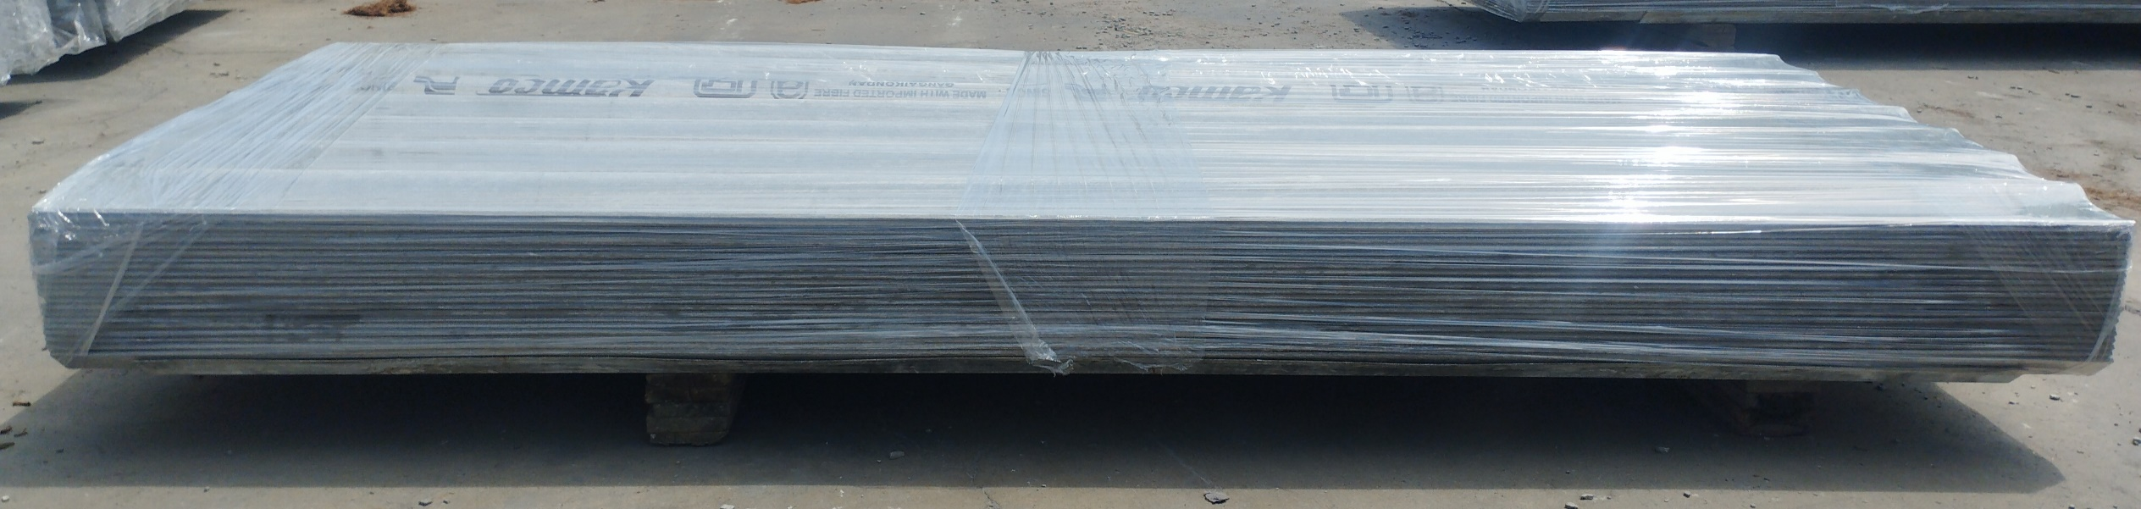
2.50 m Up Lap 22 Nos

Slide 23
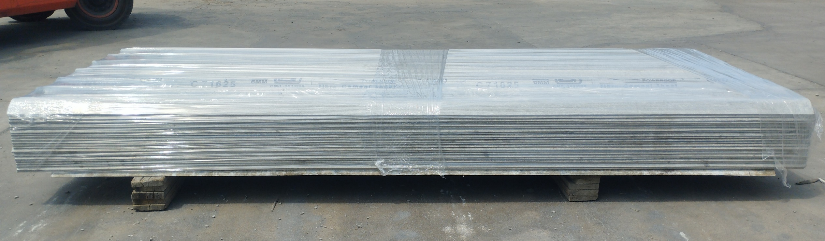
2.50 m Up Lap 22 Nos

